Slide 1
MULTITHREADING

Slide 2
Multithreading
Program is a sequence of statements.
A Program may be divided into two or more sub programs, this sub programs are called process.
Many Processes can be implemented at the same time in parallel (parallel Execution).
Process can be divided into further small parts in its sub process (threads).
That sub-process is called Thread.
We can say “Thread” is a smallest unit of a program.

Slide 3
Multithreading
Important terms
Multiprogramming: More than one program running at same time. That can share same Processor.
Multiprocessing: two or more processes of a program running at same time. They can process on the own (different) memory location.
Multithreading: two or more thread of a process executing in parallel. That can share same memory location in the memory.
Multitasking: multiple task performed at a time

Slide 4
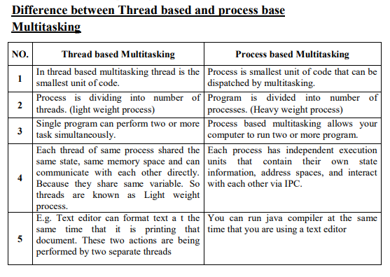

Slide 5
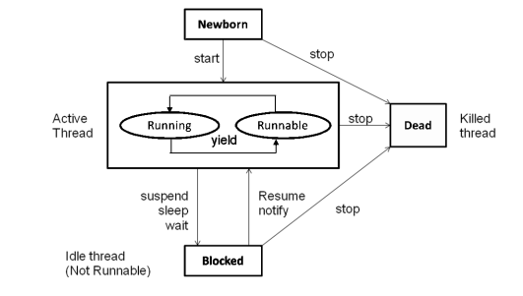
Thread life cycle

Slide 6
Multithreading
During the life time of a thread ,there are many states it can enter, They are:
1. Newborn state
2. Runnable state
3. Running state
4. Blocked state
5. Dead state
A thread is always in one of these five states. It can move from one state to another via a variety of ways.

Slide 7
Multithreading
1 ) New born state
• When we create a thread object, the thread is born and is said to be in newborn state.
• The thread is not still scheduled for running.
• At this time we can do only one of following with it:
Scheduled it for running using start () method.
Kill it using stop () method.
• If thread scheduled ,it moves to the runnable state
• If we attempt to use any other method at this stage, an exception will be thrown.

Slide 8
Multithreading
2) Runnable state
• Runnable state means that the thread is ready for execution and is waiting for the availability of the processor.
• The threads has joined waiting queue for execution.
• If all threads have equal priority, then they are given time slots for execution in round robin fashion. i. e. first-come, first serve manner.
• Thread which leaves control, joins the queue at the end and again waits for its turn. This process of assigning time to thread is known as time-slicing.
• If we want a thread to leave control to another thread of equal priority before its turn comes ,then yield( ) method is used

Slide 9
Multithreading
3) Running state
• Running means that processor has given its time to the thread for its execution. The thread runs until it relinquishes control on its own or it is preempted by a higher priority thread. A running thread may change its state to another state in one of the following situations.
When It has been suspended using suspend ( ) method - This is used when we want to suspend a thread for some time due to certain reason, but do not want to kill it.
It has been made to sleep ( ) - We can put a thread to sleep for a specified time period using the method sleep (time) where time is in milliseconds.
When it has been told to wait until some events occurs - This done using the wait ( ) method. The thread can be scheduled to run again using notify () method.

Slide 10
Multithreading
4) Blocked state
• A thread is said to be blocked when it is prevented from entering into the runnable state and subsequently the running state.
• This happens when the thread is suspended, sleeping or waiting in order to satisfy certain requirements.
• A blocked thread is considered “not runnable” but not dead and therefore fully qualified to run again

Slide 11
Multithreading
5) Dead state
• Every thread has a life cycle. A running thread ends its life when it has completed executing its run ( ) method.
• It is natural death. However we can kill it by sending the stop message to it as any state thus causing a premature death for it.
• A thread can be killed as soon it is born or while it is running or even when it is in “blocked” condition.

Slide 12
Main thread
• When a java program starts up, one thread begins running immediately.
• It is the one that is executed when your program begins, so it is usually called the
main thread of your program.
• Main thread is important for two reason:
It is the thread from which other “child” threads will be created.
It must be the last thread to finish execution because it performs various shutdown actions.
• Main thread is created automatically when your program is started .it can be controlled through a Thread object. We can refer that object by calling method currentThread() which is public static member of Thread.
• Syntax: static Thread currentThread ( )
• This method returns reference to the thread in which it is called. If we have reference to main thread, we can control it as any other thread.
• By default, the name main thread is main.

Slide 13
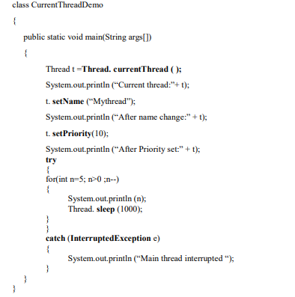
Multithreading
Output:
Current thread: Thread [main, 5, main]
After name change: Thread [My Thread, 5, main]
After Priority set: Thread [My Thread, 10, main]
5
4
3
2
1

Slide 14
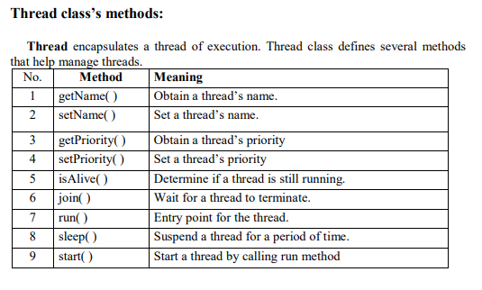
Multithreading

Slide 15
Creating a thread
• We can create a thread by instantiating an object of type Thread.
• The run () method is the heart and soul of any thread.
• run( ) method makes up the entire body of a thread and is the only method in
which the thread’s behaviour can be implemented.
Syntax: public void run( )
{…………
………… // (statement for implementing thread)
}
• The run ( ) method should be invoked by an object of concerned thread. For that we have to create thread and initiate it with the help of other thread method called start ().

Slide 16
Multithreading
Java can create a thread by following two ways:
1) You can implement the Runnable interface.
2) You can extend the Thread class.

Slide 17
Multithreading
1) Implementing the ‘Runnable’ interface
The Runnable interface declares the run ( ) method that is required for implementing
threads in our programs.
Steps to implement Runnable interface:
1. Declare the class as implementing the Runnable interface.
2. Implement the run ( ) method.
3. Create a thread by defining an object that is instantiated from this “runnable”
class as the target of the thread.
4. Call the thread’s start( ) method to run the thread

Slide 18
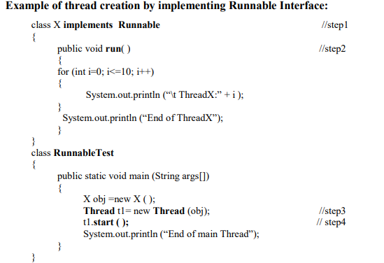
Multithreading
1) You can implement the Runnable interface.
Output:
End of main Thread
ThreadX: 1
ThreadX: 2
ThreadX: 3
ThreadX: 4
ThreadX: 5
ThreadX: 6
ThreadX: 7
ThreadX: 8
ThreadX: 9
ThreadX: 10
End of ThreadX

Slide 19
Multithreading
2) Extending the thread class
The Thread class declares the run ( ) method that is required for overriding threads in our programs.
We can make our class runnable by extending the class java.lang.Thread.
To extend Thread class, perform following steps:
1. Declare the class as extending the Thread class.
2. Implement the run ( ) method that is responsible for executing the sequence of code that the thread will execute.
3. Create a thread object and call the start ( ) method to initiate the thread execution.

Slide 20
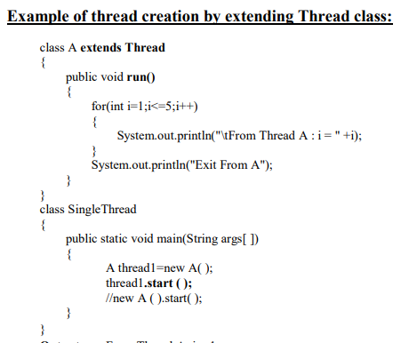
Multithreading
2) You can extend the Thread class.
Output:
From Thread A: i = 1
From Thread A : i = 2
From Thread A : i = 3
From Thread A : i = 4
From Thread A : i = 5
Exit from A

Slide 21
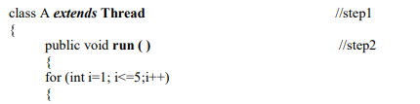
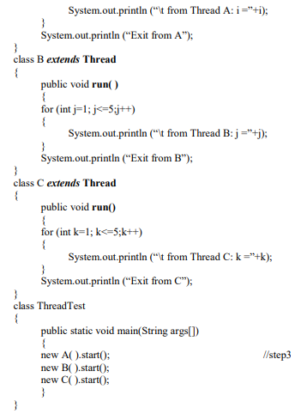
Write a program to create multiple thread.
Output:
First run
From Thread A : i = 1
From Thread A : i = 2
From Thread B : j = 1
From Thread B : j = 2
From Thread C : k = 1
From Thread C : k = 2
From Thread A : i = 3
Second run
From Thread A : i = 1
From Thread A : i = 2
From Thread C : k = 1
From Thread C : k = 2
From Thread A : i = 3
From Thread A : i = 4
From Thread B : j = 1
From Thread A : i = 4
From Thread B : j = 3

Slide 22
Using isAlive ( ) and join( ) methods
In Multi-threading, one thread can know when another thread has ended or
not by using two methods isAlive ( ) and join ( ) method.
1) isAlive() :
• We can know state of any thread by these methods.
• This method is defined by Thread class .
its general form is : final boolean isAlive ( )
It returns true if the thread upon which it is called is still running,
It returns false otherwise.
This method is occasionally useful.

Slide 23
Using isAlive ( ) and join( ) methods
2) Join() :
•The join method causes the current thread to wait until the thread upon which
the join ( ) method is call, gets terminates.
• It s name comes from the concept of calling thread waiting until the specified
thread joins it.
• join ( ) also allows to specify a maximum amount of time that user want to
wait for the specified thread to terminate.
• This method is defined by Thread class .its general form is :
final void join( ) throws InterruptedException
Where the join () method either suspends the current thread for timeout
milliseconds or until the thread it calls on terminates.
• This method is commonly used.

Slide 24
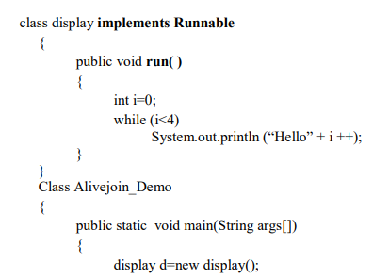
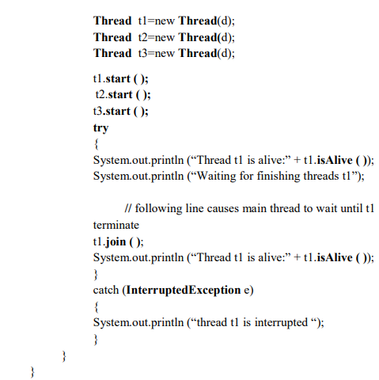
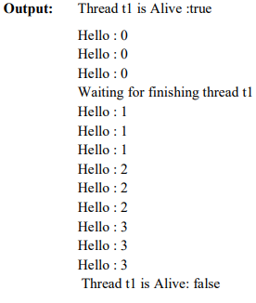
Using isAlive ( ) and join( ) methods

Slide 25
Threaded priority
Every thread in java has its own priority.
• Thread priority are used by thread scheduler to decide when each thread
should be allowed to run.
• In theory, higher priority threads get more CPU time than lower priority
threads.
• When a lower priority thread is running higher priority thread resumes
(from sleeping or waiting for on I/O), it will preempt the lower priority
thread.
• Threads of equal priority should get equal access to the CPU. For this,
thread that share the same priority should yield control once in while.
• Every new thread that has created, inherits the priority of the thread that
creates it.

Slide 26
Threaded priority
• The priority is an integer value. Priority is in the range of 0 to 10.(
Thread.MAX_PRIORITY(0) to Thread.MAX_PRIORITY( 10 ) )
• To return thread to default priority ,specify NORM_PRIORITY (5) .
• These priorities are defined as final variables within Thread.
• If the value is out of this range than the method throws an exception
IllegalArgumentException.
• Most user level processes should use NORM_PRIORITY .
• Background tasks such as Network I/O and screen repainting should use a
value very near to lower limit.
• We should be very careful when trying to use very higher priority values.
• By assigning priorities to threads, we can ensure that they are given the
attention they deserve.

Slide 27
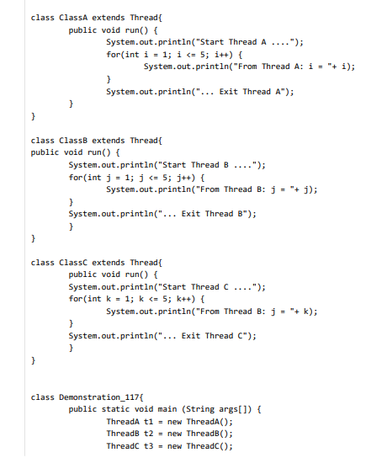
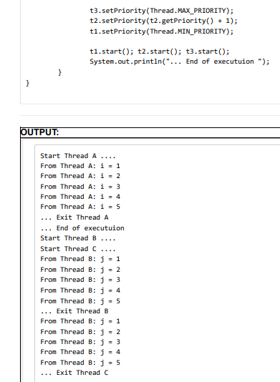
Threaded priority

Slide 28
Synchronization
• When two or more threads need to access to a shared resource, they need some way to ensure that the resource will be used by only one thread at a time. The process of achieving this is called synchronization.
For example, one thread may try to read a record from a file while
another is still writing to the same file. Depending on situation we may get
strange result. We can avoid this by synchronization.
• Monitor (semaphore) concept is key to synchronization.
• Monitor is an object that is used as a mutually exclusive lock or mutex.
• Only one thread can own a monitor at a given time.
• When a thread acquires a lock, it is said to have entered the monitor. Monitor
is like a key and the thread that holds the key can only open the lock.
• All the other threads attempting to enter the locked monitor will be
suspended until the first thread exists the monitor. This other threads are said
to be waiting for the monitor

Slide 29
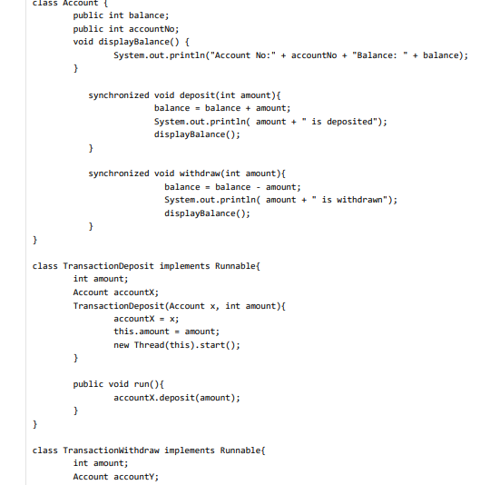
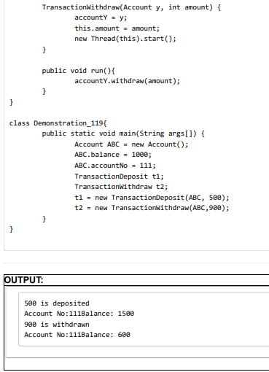
Synchronization

Slide 30
Synchronization
We want to maintain a bank account of customers. Several transactions, such as deposit some amount to an account and withdraw some amount from an account etc. are possible. Now, for a given account, if two or more transactions come simultaneously then only one transaction should be allowed at a time instead of simulataneous transaction processing so that data inconsistency will never occur. So, what we need is to synchronize the transaction.
the keyword synchronized is used for the methods void deposite(..) and void withdraw(..) so that these two methods will never run for the same object instance simultaneously

Slide 31
Interthread communication
• Polling is used to check condition repeatedly. Once condition is true appropriate action is taken. In polling system, consumer would waste many CPU cycles, while it waited for producer to produce. Once producer complete it waits for to complete consumer to finish.
• To avoid polling, Java includes inter process communication mechanism via the wait (), notify( ) and notifyAll ( ) methods.
• These methods are implemented as final methods in object. (in package java.lang.Object)
• All three methods can be called only from within a synchronized context.
1. Wait( ) tells the calling thread to give up the monitor and go to sleep until some other thread enters the same monitor and calls notify().
Syntax: final void wait () throws InterruptedException
2. notify() wakes up the first thread that called wait () on the same object.
Syntax: final void notify()
3. notifyAll() wakes up all the threads that called wait() on the same object. The highest priority thread will run fast.
Syntax : final void notifyAll()

Slide 32
Suspending, resuming & stopping threads
1. Stopping a thread :stop() - syntax : threadName.stop();
This causes the thread to move to dead state. A thread will also move to dead state automatically when it reaches end of its method. The stop( ) method may be used when premature death of a read is desired.
2. Resuming thread - syntax : threadName.resume();
• This causes thread to move to runnable state. A thread will also move to dead state automatically in certain situation.
3. Suspending thread :sleep() ,wait() and suspend() - This all causes the thread to move to Blocked state
• threadName.sleep(t); This makes thread to sleep for t time (in milisecond), after time elapsed thread will goes into runnable state.
• threadName.wait(); This tells thread to wait for some event to complete, to gain control notify() method is called of that thread.
• threadName.suspend(); This suspends thread for some reason and then using resume () method thread goes into runnable state.

